Slide 1
Forecasting Apple Stock Market Price
GROUP 6
Adithya A
Aswathi V K
V. Madhu Hasitha
Komal Dadarao Ghatol
B. Shyam Prakash Reddy
Subham Rajkumar Shukla

Slide 2
Contents
Introduction
About the Data
Objective of the Study
EDA
Model Building & Evaluation
Model Deployment
Challenges Faced During the Project
Overcame the Challenges
Conclusion

Slide 3

Introduction
Stock market analysis is the process of evaluating financial instruments, market trends, and economic factors to make informed investment decisions. It involves studying past and present market data, company performance, and economic indicators to predict future price movements of stocks and other securities.
Stock market forecasting is a crucial task in financial analysis, enabling investors and analysts to make informed decisions.
Predicting stock prices accurately can help in risk management, portfolio optimization, and strategic investments.

Slide 4
About the Data
Data of Apple stock price starting from 2012 to 2019.
Historical data including Open, High, Low, Close, Adjusted Close price and Volume.

Slide 5
Objective of the Study
Predict the apple stock market price for the next 30 days.

Slide 6
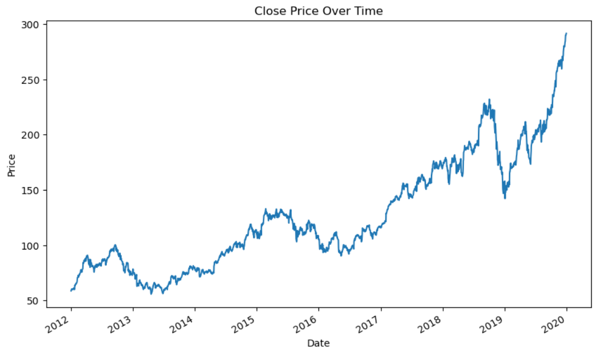
Exploratory Data Analysis
This plot represents the closing price of Apple Inc. (AAPL) stock over time from 2012 to 2019. The trend shows a general upward movement with periods of volatility, corrections, and significant growth, especially toward the end of the timeframe.
Line Plot of Closing Price

Slide 7
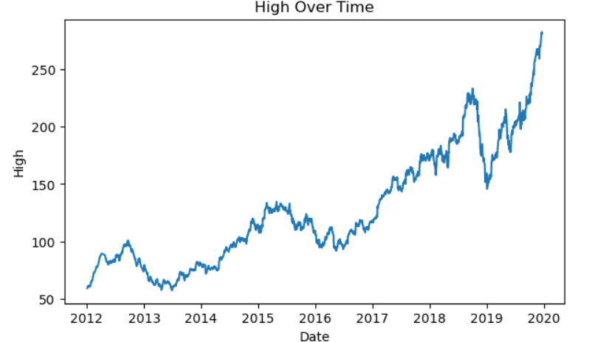
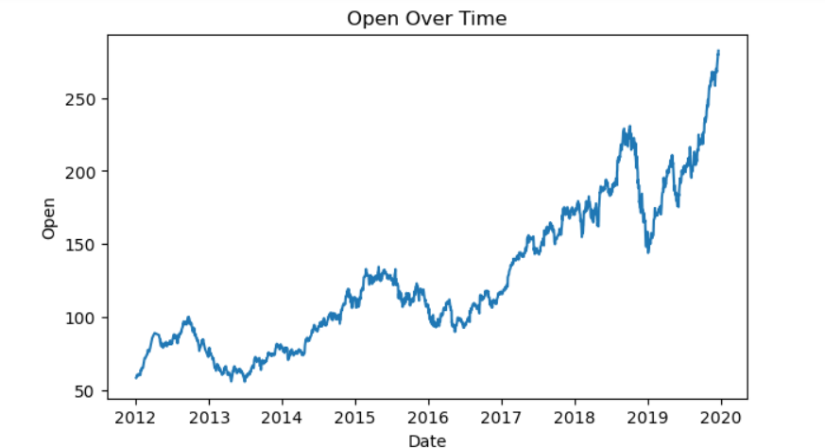
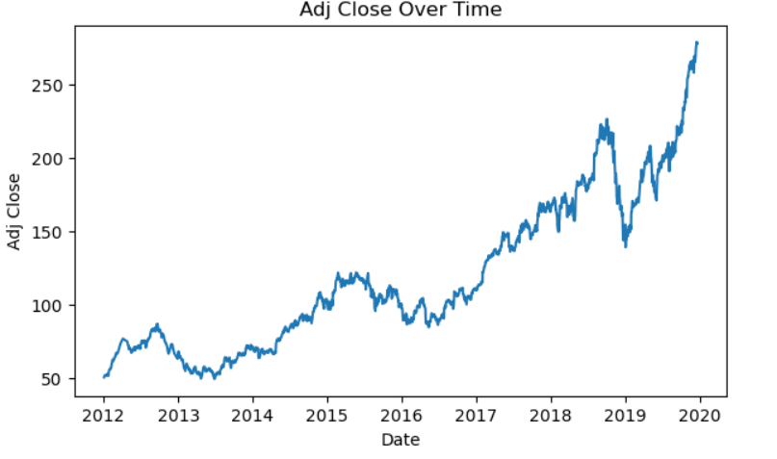
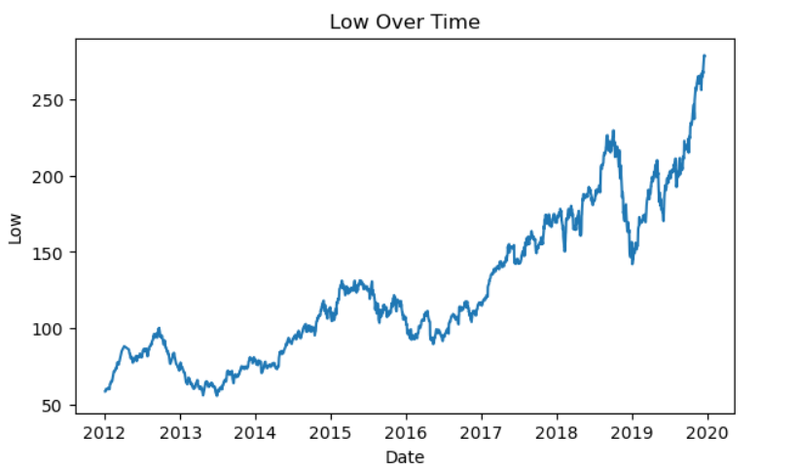
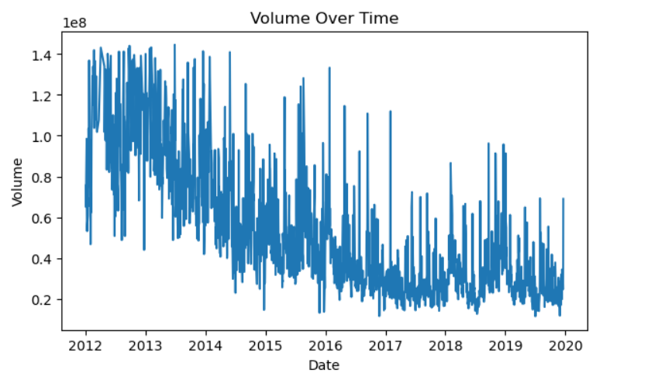
Line plot of other features

Slide 8
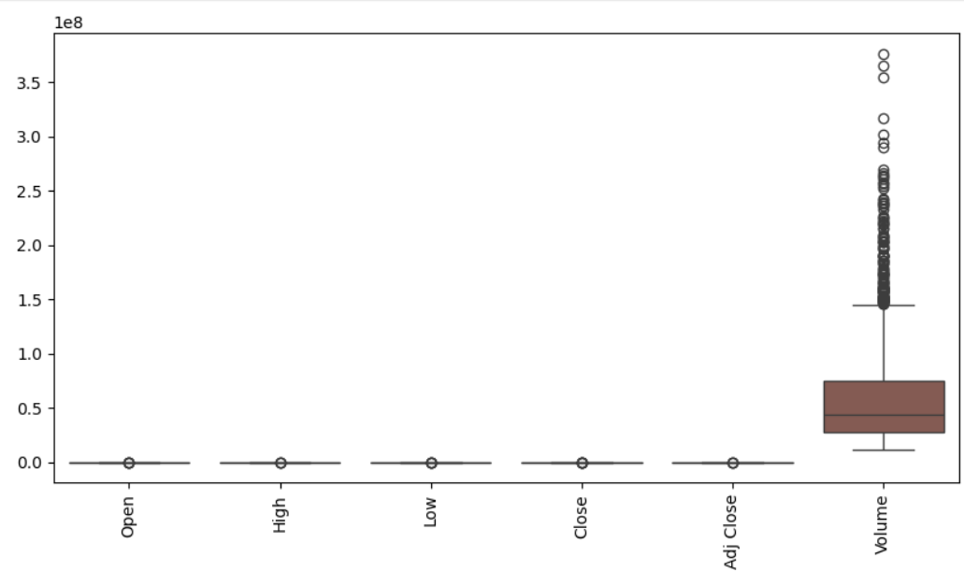
Box plot
This box plot visualizes the distribution of different stock market features for Apple Inc. (AAPL), including Open, High, Low, Close, Adjusted Close, and Volume.
Stock Price Columns (Open, High, Low, Close, Adjusted Close)
These values are tightly clustered with very few outliers.
The range of variation is small, indicating a relatively stable price movement over time.
Volume
Unlike the price-related columns, trading volume shows significant variability.
The presence of numerous outliers suggests that on certain days, Apple stock had very high trading activity.
This could be due to major events like earnings releases, product launches, or macroeconomic factors affecting
investor sentiment.

Slide 9
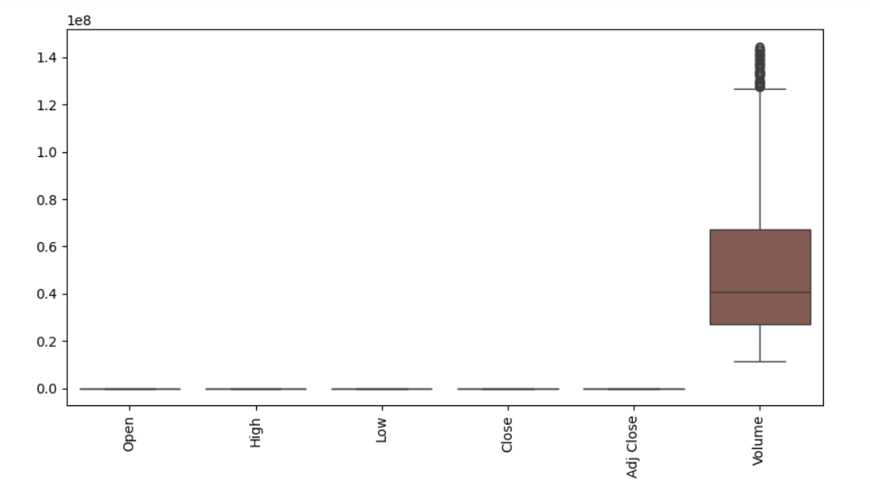
Box plot after data cleaning
This box plot represents Open, High, Low, Close, and Adjusted Close prices of Apple Inc. (AAPL) stock after data cleaning (i.e., after removing outliers).
Smoother Price Distributions
With outliers removed, the price distributions appear more compact and symmetric, reflecting a more stable stock price trend.
The median values remain similar, suggesting that extreme values did not significantly impact the central tendency.
Reduced Variability
The inter-quartile range (IQR) is now more refined, indicating less extreme price fluctuations after removing unusually high or low values.
This makes the dataset cleaner and more reliable for time series forecasting.
Consistent Price Movements
The Open, High, Low, Close, and Adjusted Close prices are closely aligned, reinforcing minimal price divergence during trading sessions.
This suggests that Apple’s stock price movements were relatively steady over time, with only moderate variations.

Slide 10
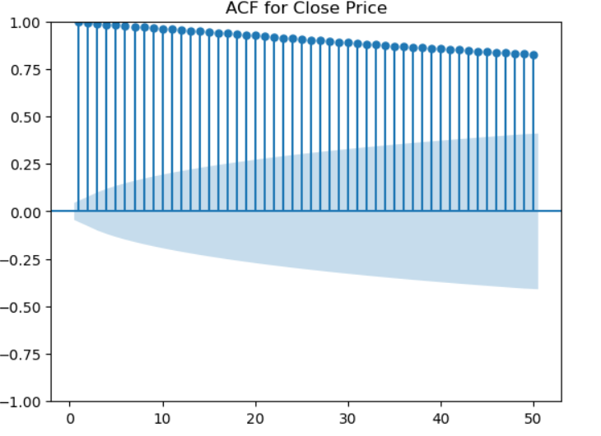
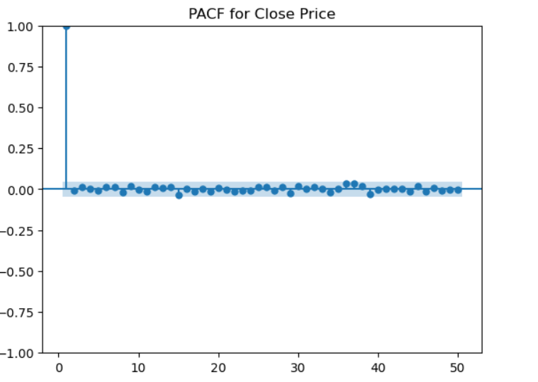
ACF and PACF of Close Price
The first image represents the Autocorrelation Function (ACF) for the Close Price, while the second image shows the Partial Autocorrelation Function (PACF) for the Close Price.
ACF Plot:
The ACF values are very high and decay gradually, indicating a strong autocorrelation.
This suggests that the time series is non-stationary, meaning it has a trend or strong dependence on past values.
To make the series stationary, differencing needed.
PACF Plot:
The PACF shows a strong lag-1 correlation, with all other lags being insignificant.
This suggests an AR(1) process, meaning the series primarily depends on its immediately preceding value.

Slide 11
ADF Test
ADF Statistic: 0.8530604319404594
p-value: 0.9924461341921569
Critical Values: {'1%': -3.433851764270508, '5%': -2.863086831883029, '10%': -2.5675934770796993}
The data is non-stationary (fail to reject the null hypothesis).
ADF test confirmed the non-stationarity .So Differencing needed in this data.

Slide 12
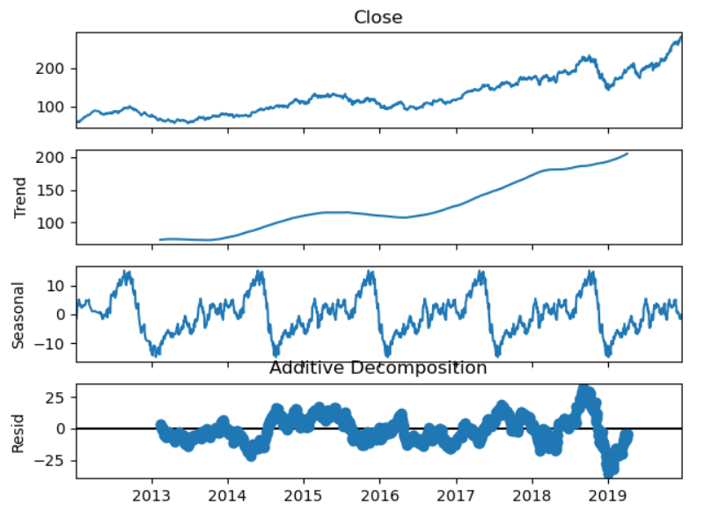
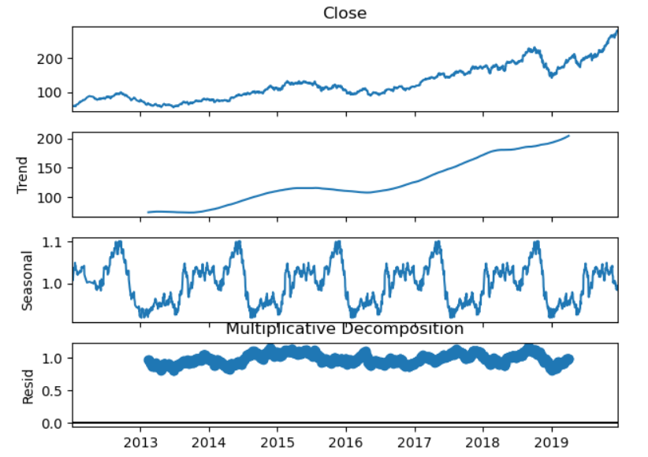
Additive and Multiplicative Decomposition
Additive Residual Variance: 108.52432130018883
Multiplicative Residual Variance: 0.005713966394712331
Multiplicative model has lower residual variance, it’s better for this data.

Slide 13
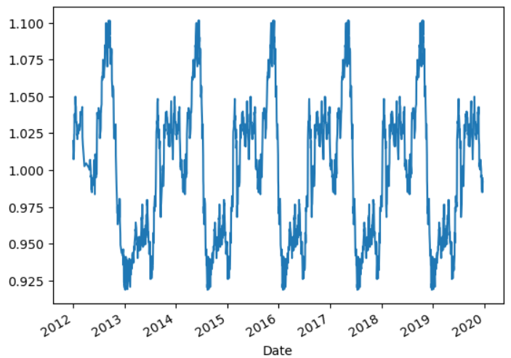
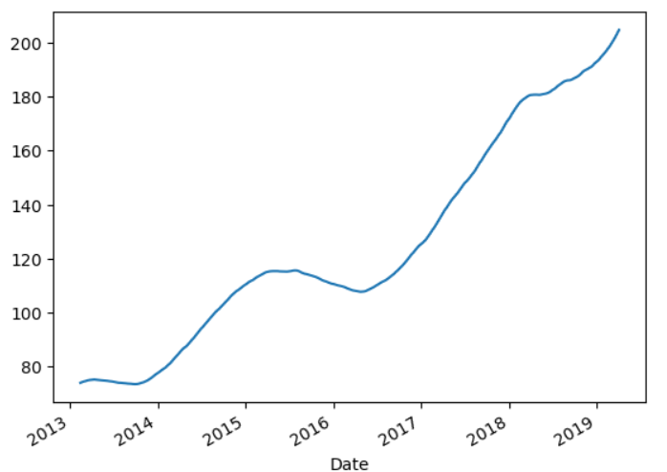
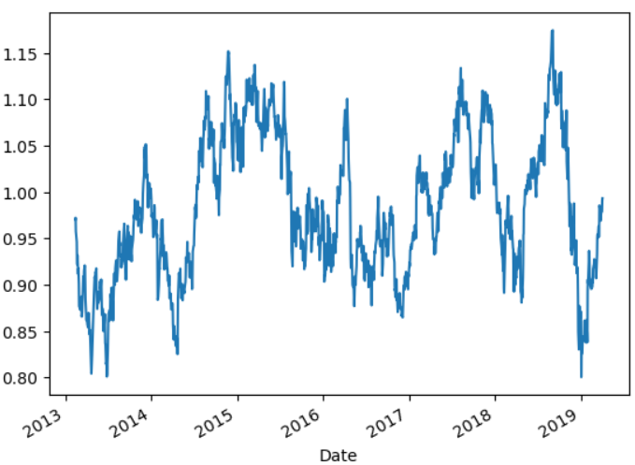
Seasonal Plot
Trend Plot
Residual Plot

Slide 14
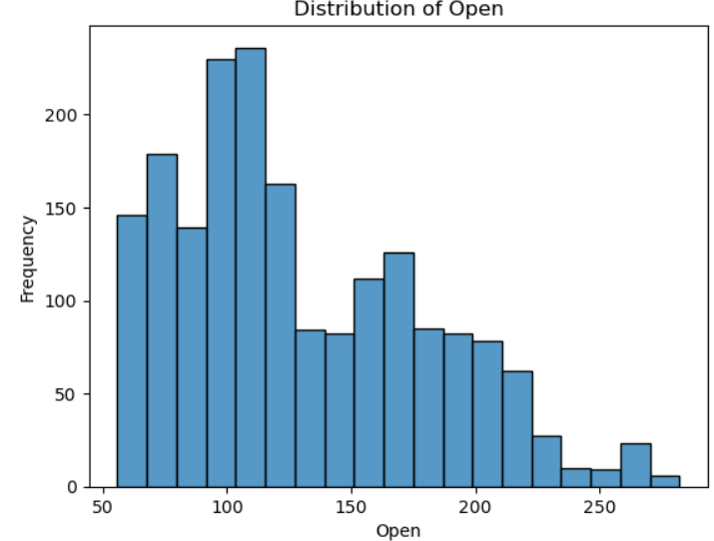
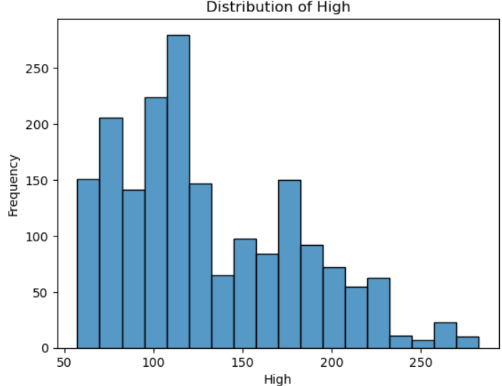
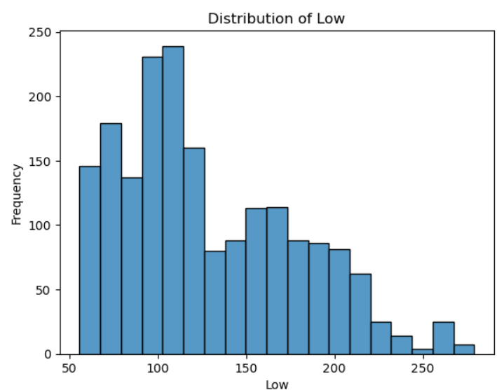
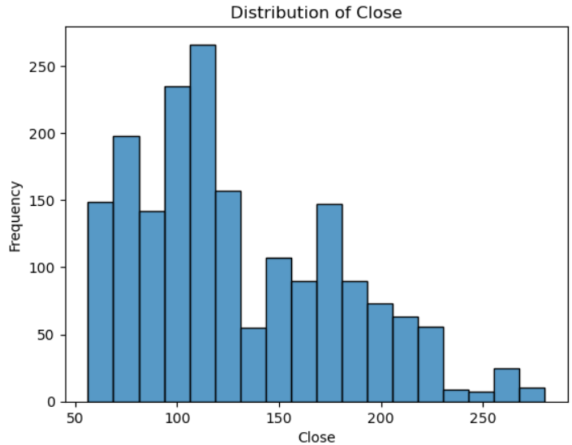
Histogram

Slide 15
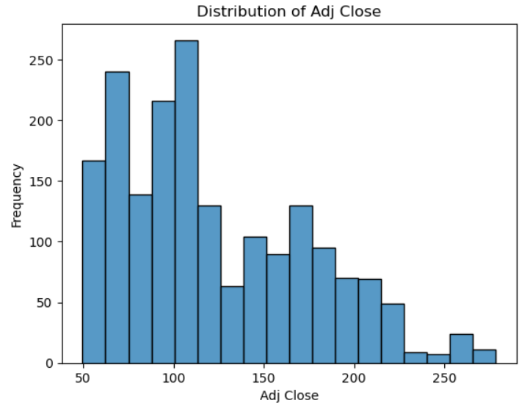
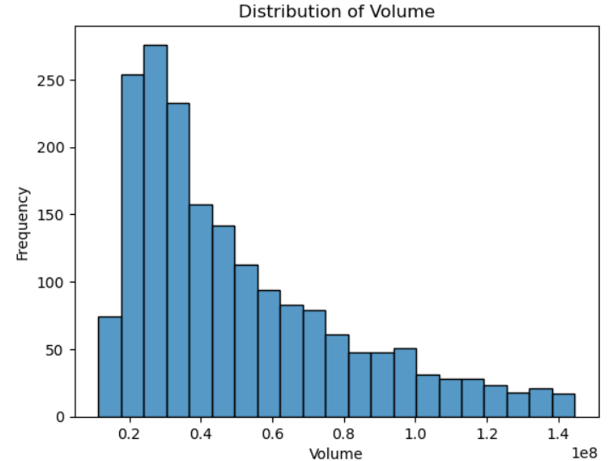

Slide 16
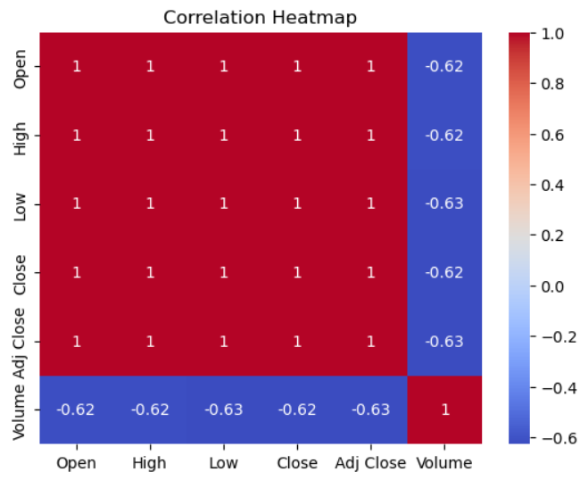
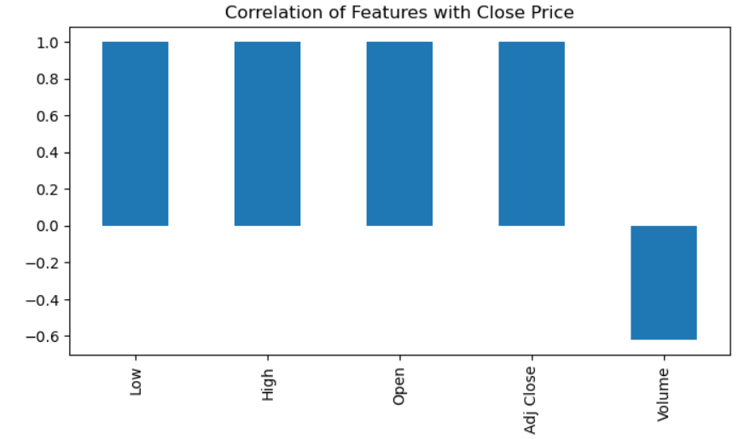
Correlation

Slide 17
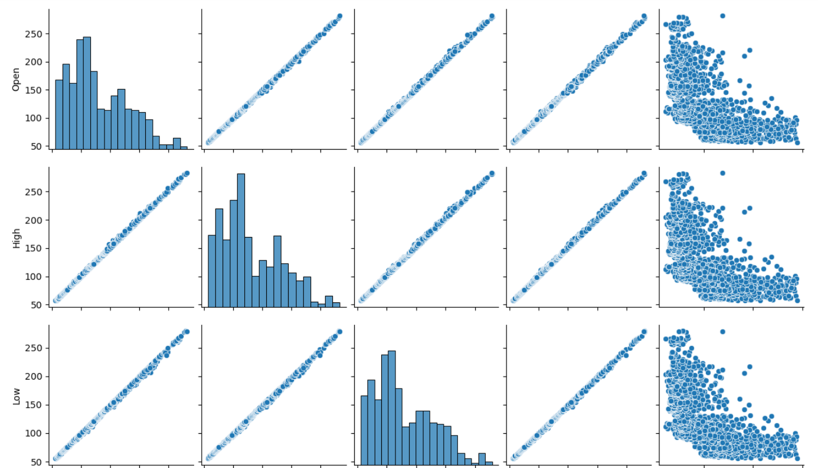
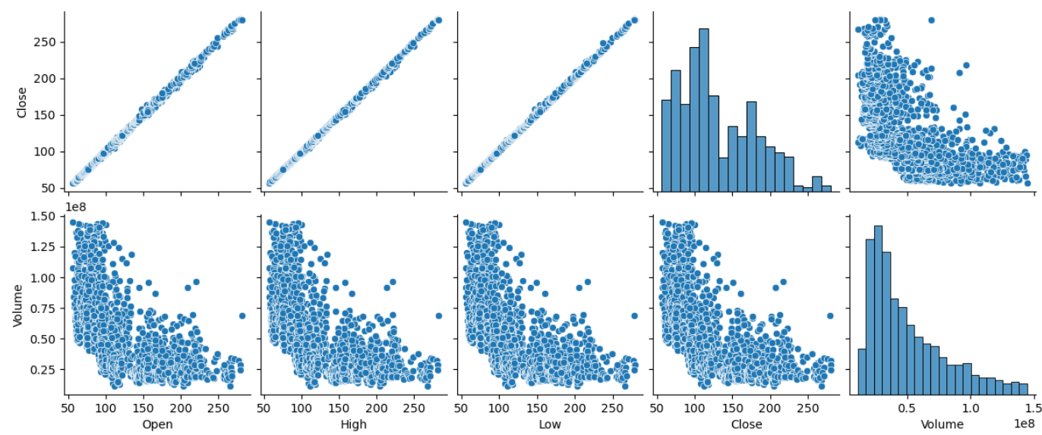
Pair Plot

Slide 18
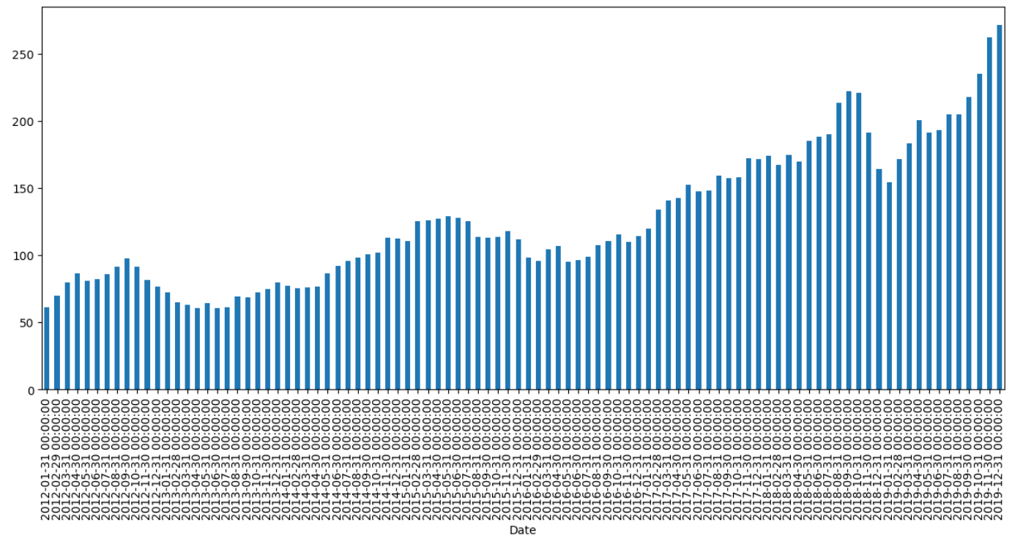
Bar chart of monthly data

Slide 19
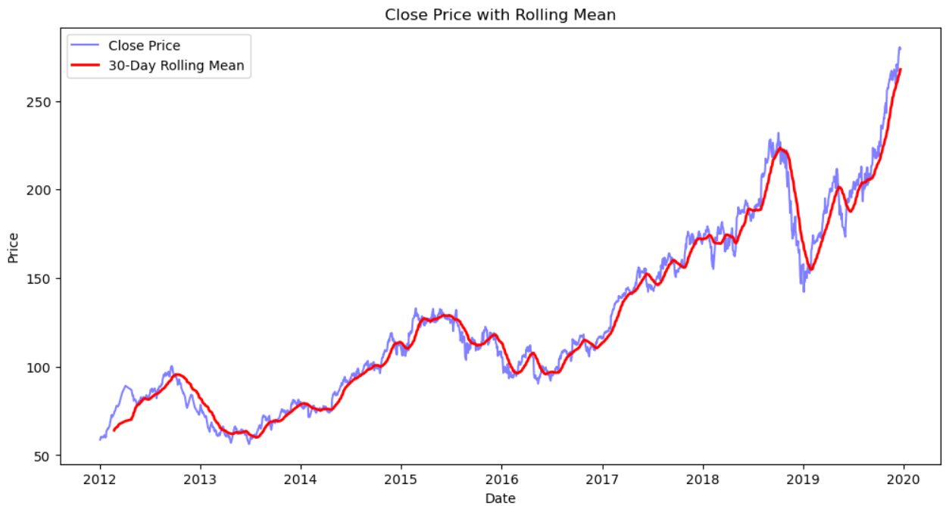

Slide 20
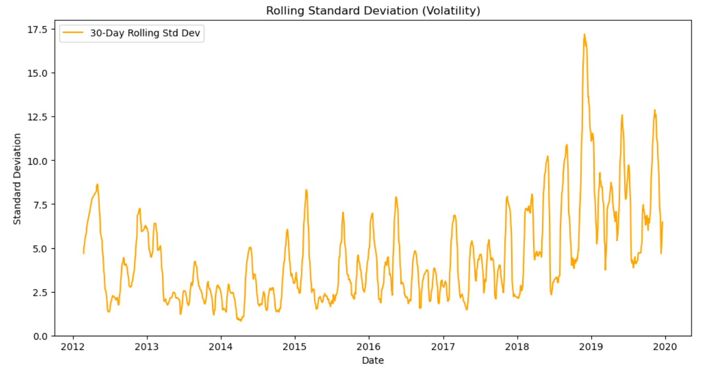

Slide 21
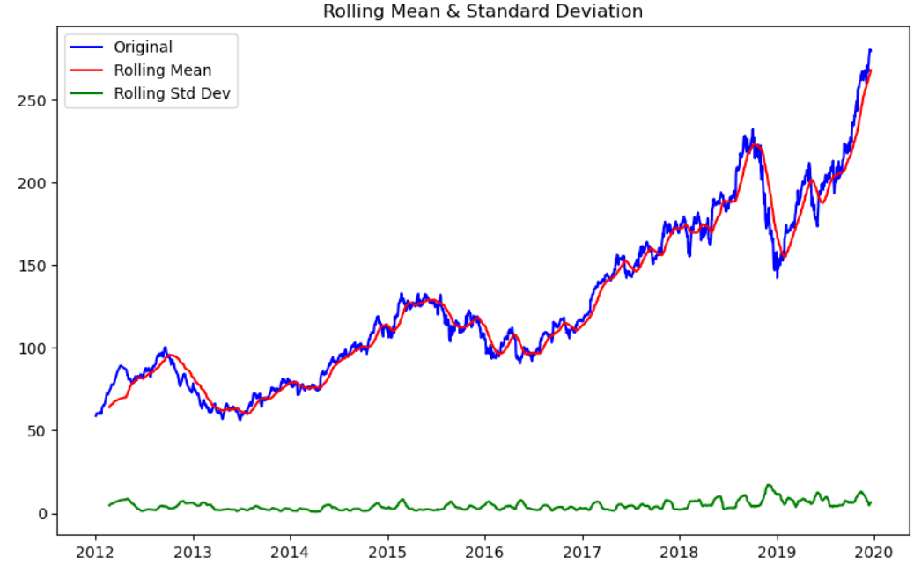

Slide 22
Differencing
A Technique used in time series analysis to transform a non-stationary time series into a stationary one.
Stationarity Confirmation after differencing
ADF Statistic: -13.85274604705397
p-value: 6.956458839371473e-26
Critical Values: {'1%': -3.4340986745839315, '5%': -2.8631958309688113, '10%': -2.567651515683604}
The data is stationary (reject the null hypothesis).
Stationarity condition satisfied.

Slide 23
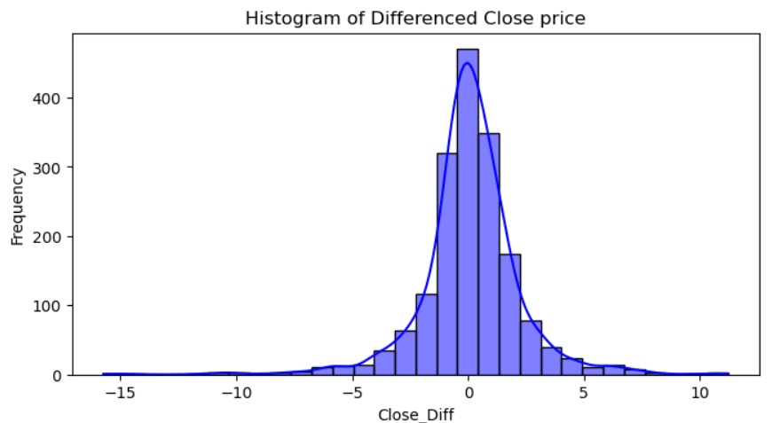
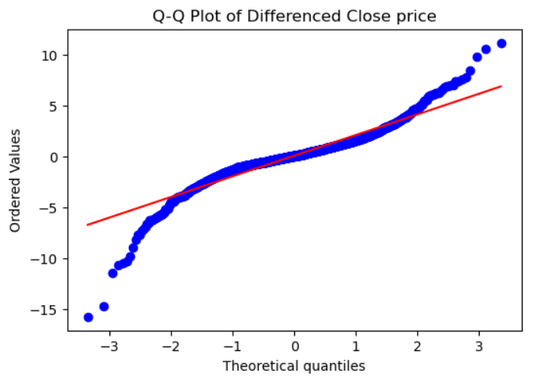
Histogram showing that data points are normally distributed.
From Q-Q plot, most of the data points are close to the straight line which indicates the normality.
So, stationarity and normality condition satisfied.

Slide 24

MODEL BUILDING AND EVALUATION
Model building involves transforming data into actionable insights.

Slide 25
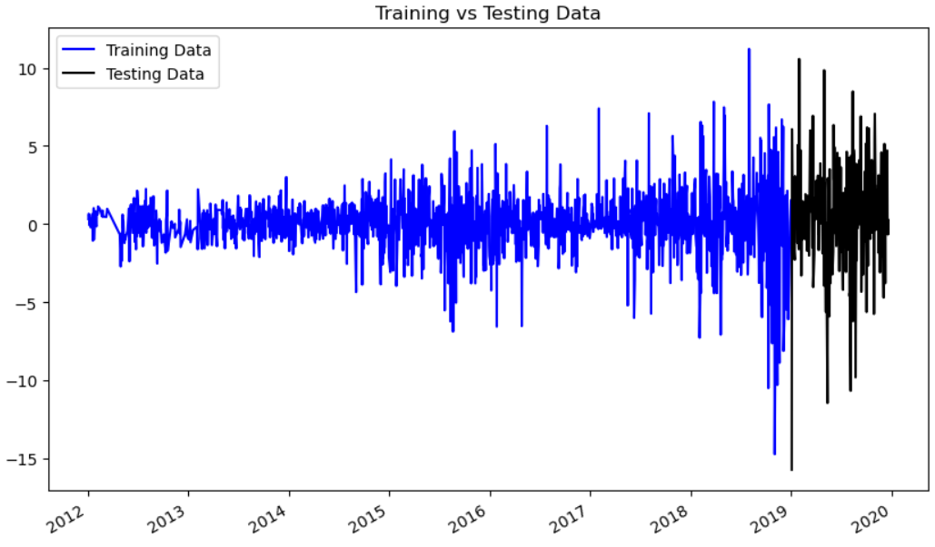
Training vs Testing of differenced data

Slide 26
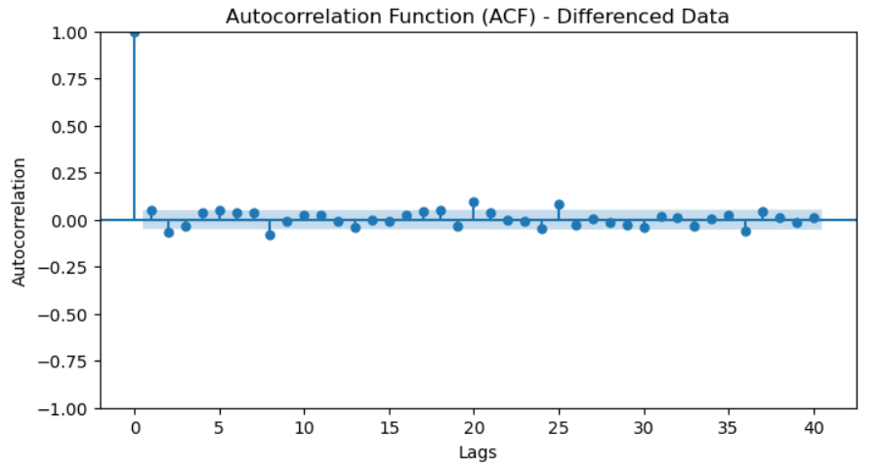
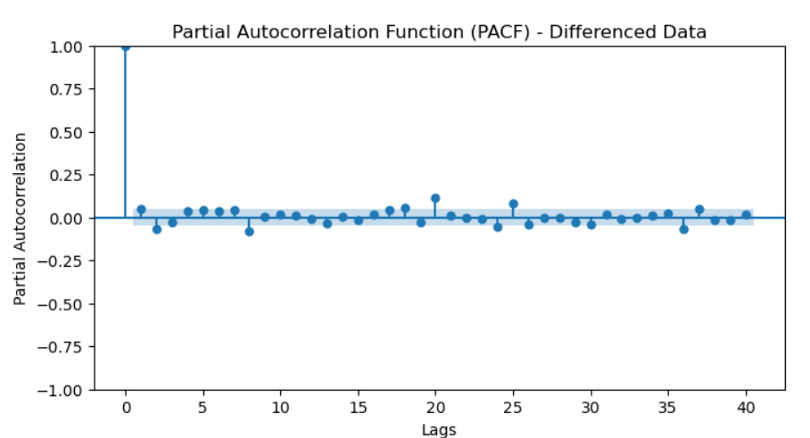
There is no such high autocorrelation present here.

Slide 27
MODEL EVALUATION
Model | MAE | MSE | RMSE | R² | AIC | BIC
ARIMA(2,0,2) | 2.43 | 11.09 | 3.33 | 1.00 | 6213.93 | 6245.88
SARIMA(2,0,2)(2,0,4)[12] | 2.42 | 11.16 | 3.34 | 1.00 | 6046.13 | 6104.32
SES | 2.39 | 10.75 | 3.28 | 1.00 | 1928.69 | 1939.34
DES | 2.39 | 10.77 | 3.28 | 1.00 | 1932.67 | 1953.97
TES | 2.39 | 10.72 | 3.27 | 1.00 | 1948.08 | 2033.27
By comparing the models, Holt-Winter's Exponential smoothing (Triple ES) having Minimum errors. So, Holt Winter's model likely To perform better than the other models.

Slide 28
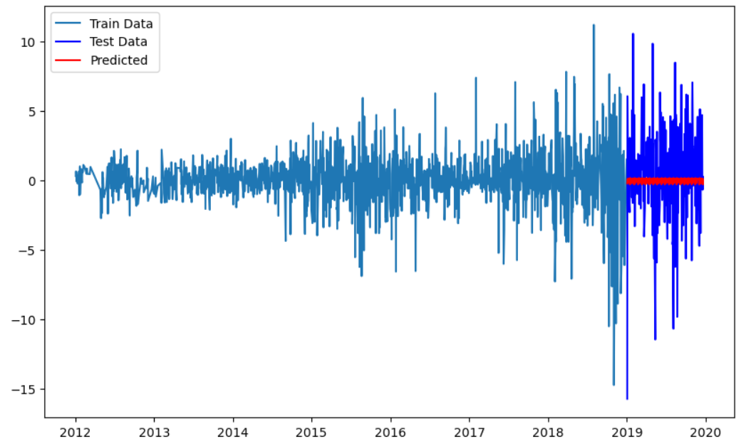
Model Building Using Triple Exponential Smoothing (Holt Winter's)
Line chart in Differenced Scale

Slide 29
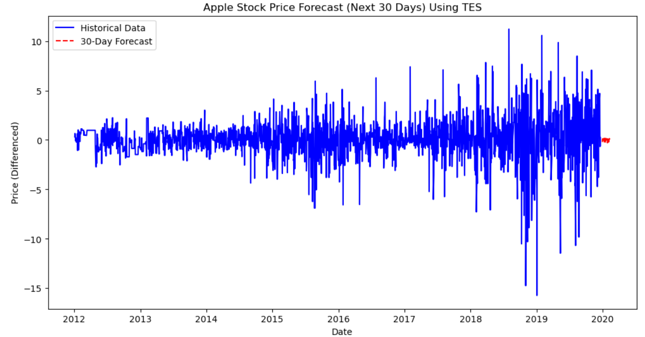
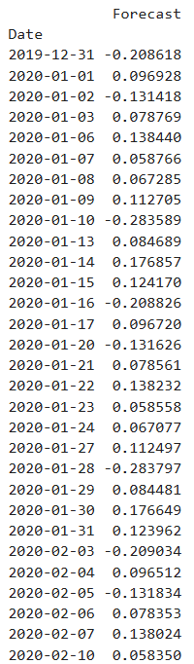
Apple Stock Price Forecast in differenced scale
Line plot of Apple Stock Price Forecast (next 30 days) in differenced scale with Historical data

Slide 30
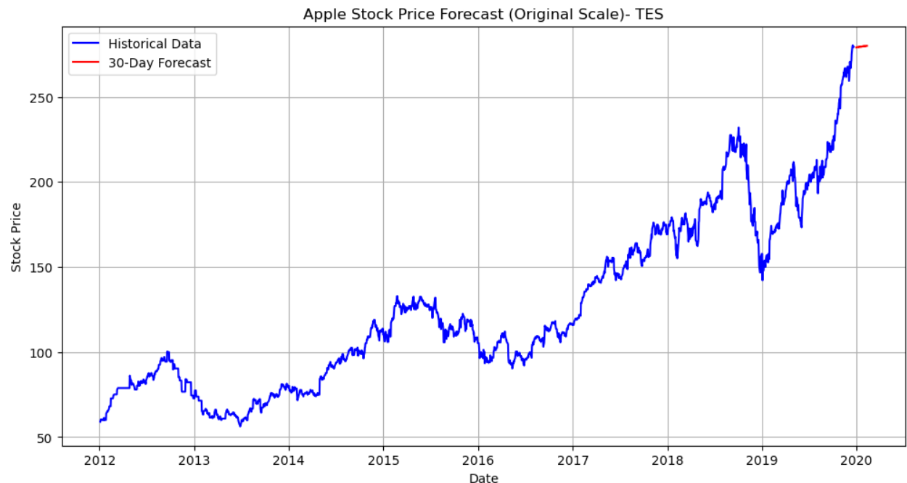
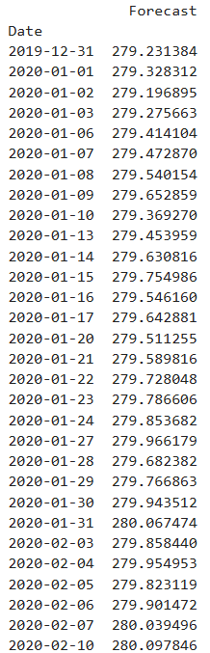
Line plot of Apple Stock Price Forecast in Original scale with Historical data
Apple Stock Price Forecast in Original scale

Slide 31
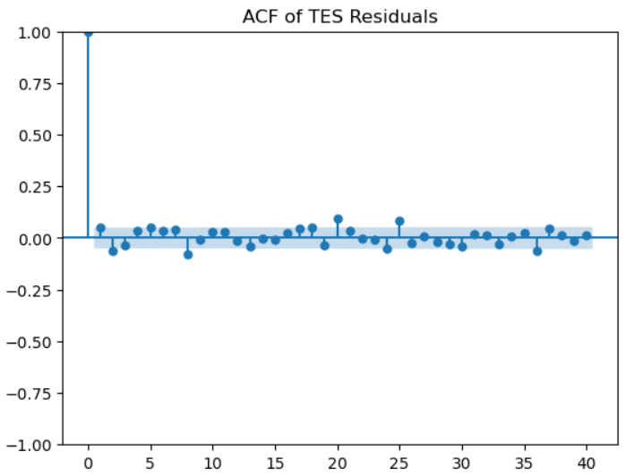
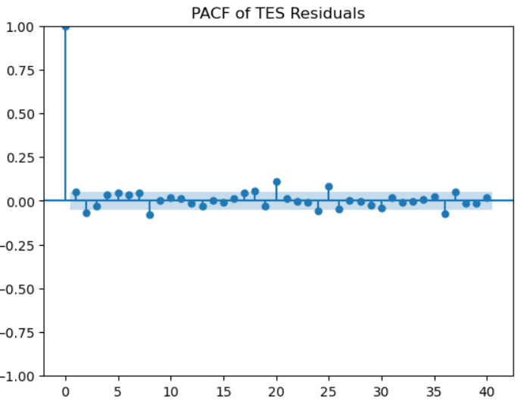
ACF and PACF of Residuals
Both plots show that autocorrelations of residuals are mostly within the confidence bounds, suggesting that residuals are approximately white noise.
This means there is no significant autocorrelation left in the residuals, which indicates a good model fit.

Slide 32
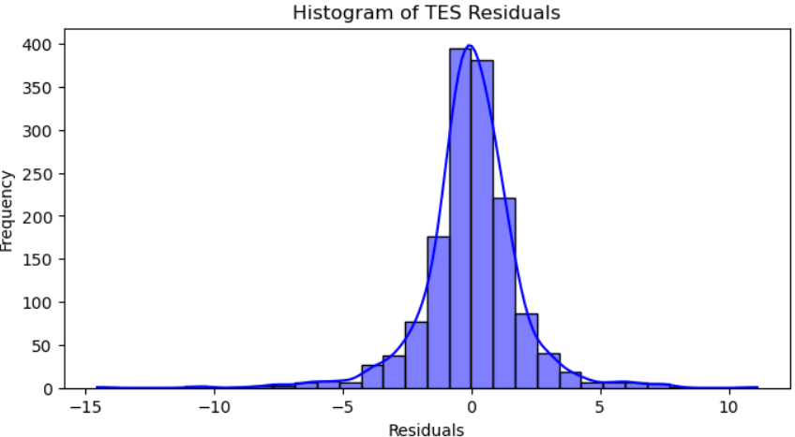
Histogram of Residuals
The histogram appears roughly normal, centered around zero.
This suggests that the residuals are normally distributed, which is a desirable property in forecasting models.

Slide 33

MODEL DEPLOYMENT
Model deployment is the process of integrating a machine learning model into a production environment.
It allows users, developers, and systems to access the model's predictions.
It enables users to make business decisions based on data.

Slide 34
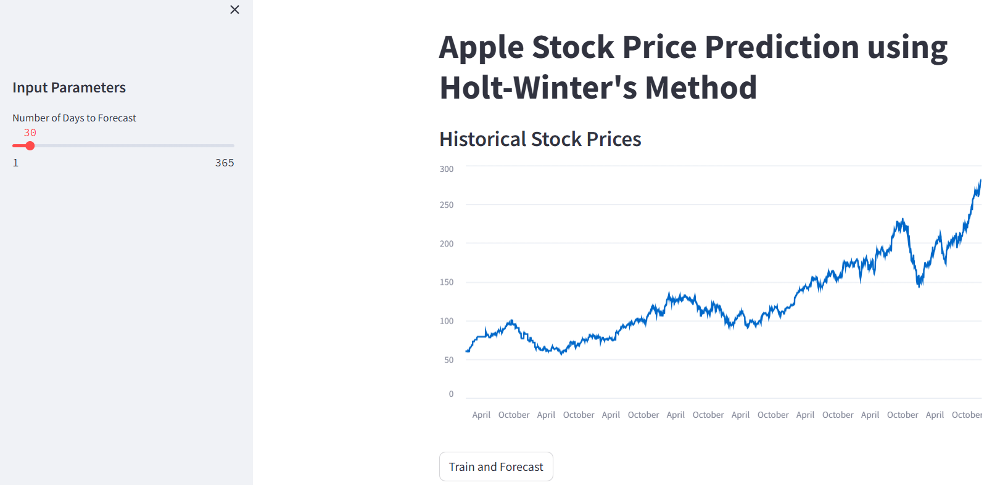
we used complete data as training set without splitting, then w e get the evaluation metrics as,
Mean Absolute Error (MAE): 1.657866660685833
Mean Squared Error (MSE): 5.38367320318375
Root Mean Squared Error (RMSE): 2.3202743810126747
R-squared (R²): 1.0
Deployment by using Streamlit

Slide 35
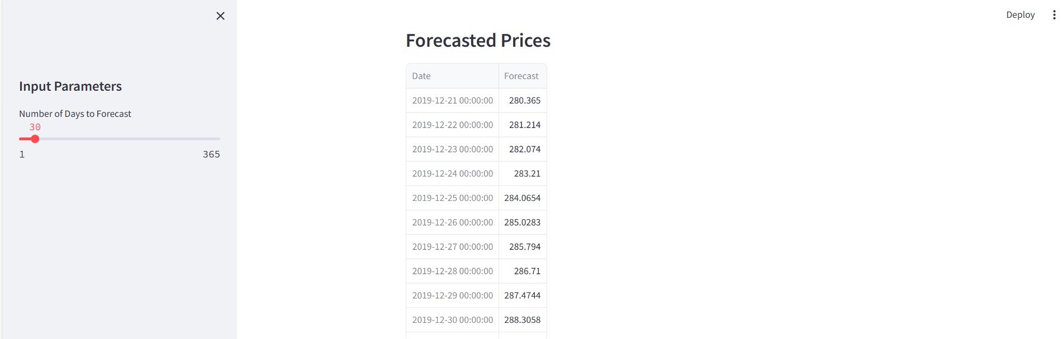
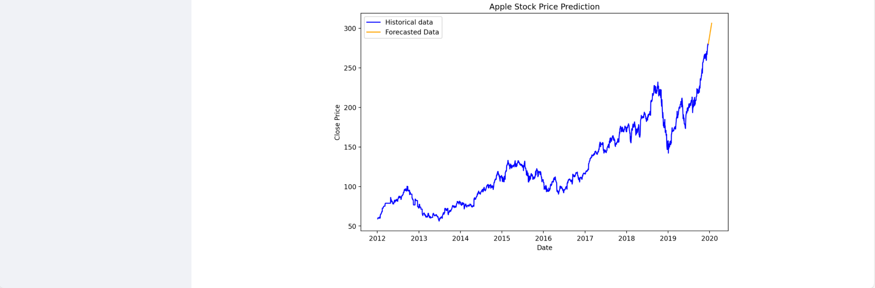
30 Days forecasted prices and it’s line plot with historical data from Streamlit App

Slide 36
Challenges Faced During the Project
Non-Stationarity: The stock price data exhibited trends and seasonality, necessitating differencing to achieve stationarity..
Presence of Outliers which required careful preprocessing.
Choosing the Right Model: Evaluating multiple forecasting models to find the best fit for the problem was challenging.
Residual Analysis: Ensuring that residuals were normally distributed and exhibited no autocorrelation required thorough statistical testing.

Slide 37
Overcame the Challenges
Applied outlier detection techniques to clean the data.
Used first-order differencing to convert the data into Stationary.
Selected Holt-Winters due to its minimal error and robust performance.
Plotted ACF , PACF and Histogram to get the normality of the data.

Slide 38
Conclusion
This project went through multiple time series models, including ARIMA, SARIMA, SES, DES, and TES.Through data preprocessing , EDA , model building and evaluation we selected Holt -Winters Model since it having minimizing errors. Using streamlit we’ve performed Deployment. In conclusion, this project demonstrates that the Holt-Winters method is an effective approach for short-term stock price forecasting.

Slide 39
Thank You

